Slide 1
Broadcast Technology UG1
DVB, Compression
Jerry Foss
jeremy.foss@bcu.ac.uk

Slide 2
DVB

Slide 3

DVB - Digital Video Broadcasting
Standards
Satellite DVB-S, DVB-S2, SH
Cable DVB-C, DVB-C2
DTT DVB-T, DVB-T2
DTT for handhelds DVB-H, DVB-H2
IPTV DVB-IPTV
DASH DVB-DASH
DVB-3DTV - Frame Compatible Plano-Stereoscopic 3DTV
DVB-C2 - 2nd Generation Cable Transmission
DVB-CID - Carrier Identification for Satellite Transmission
DVB-CPCM - Content Protection and Copy Management
DVB-FF - DVB File Format
DVB-GEM - Globally Executable MHP
DVB-GSE - Generic Stream Encapsulation
DVB-H - Broadcasting to Handheld Devices
DVB-IPDC - Internet Protocol Datacasting
DVB-IPTV - Internet Protocol Television
DVB-MHP - Open Middleware for Interactive TV
DVB-PCF - Portable Content Format
DVB-RCS2 - Return Channel Satellite
DVB-RCT - Return Channel Terrestrial (03/2001)
DVB-S2 - 2nd Generation Satellite Broadcasting
DVB-SH - Satellite Services to Handheld Devices
DVB-T - Digital Terrestrial Television
DVB-T2 - 2nd Generation Terrestrial Broadcasting
DVB - Emergency Warning System
DVB Project - An Introduction
Hierarchical Modulation in DVB-T (03/2000)
plus many others (inc addenda, etc) …
Industry Organisation
Standardisation Process –
Joint Technical Committee (JTC) of:
ETSI - European Telecommunications Standards Institute
CENELEC - European Committee for Electrotechnical Standardization CENELEC
EBU - European Broadcasting Union
Note standards refer to other standards and patents, e.g. MPEG
http://www.dvb.org/standards/factsheets

Slide 4
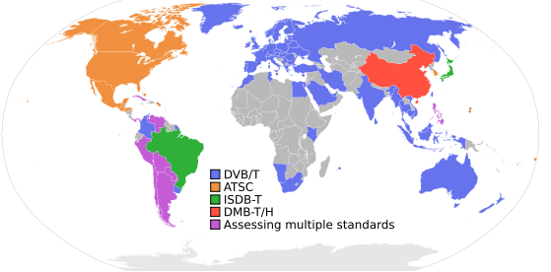
Digital Terrestrial TV (DTT)
Digital Video Broadcast, Terrestrial Television - DVB-T
Europe; also DVB-S for Satellite, DVB-C for Cable; DVB-H for handhelds
MPEG2 format; also
Integrated Services Digital Broadcasting, Television - ISDB-T
Japan; also ISDB-S for Satellite, ISDB-C for CableTV
MPEG2 format
Modulation: PSK, COFDM/PSK/QAM
Advanced Television Systems Committee - ATSC-8VSB
Modulation: 8VSB: 8-level Vestigial Sideband
American Continent
MPEG2-TS

Slide 5
DVB Specifies …
Specifies - essentially a layer one protocol for transport with Data Link (Transport Streams, GSE, etc)
Including -
Input Interface
usually Transport Streams - i.e. TV
Generic Stream Encapsulation – e.g. IP
Modes
Variable Coding and Modulation
Adaptive Coding and Modulation
FEC
e.g. DVB-T2: LDCP, BCH ½. 3/5. 2/3. ¾. 4/5. 5/6
Modulation
e.g. DVB-T2: OFDM
Modulation Schemes
Q/8/16/32PSK, QAM
e.g. DVB-C2: 16-4096QAM
Guard Interval
e.g. DVB-T2: 1/4, 19/256, 1/8, 19/128, 1/16, 1/32, 1/128 (fractions of a symbol)
Interleaving
Bit- Time- and Frequency-Interleaving

Slide 6
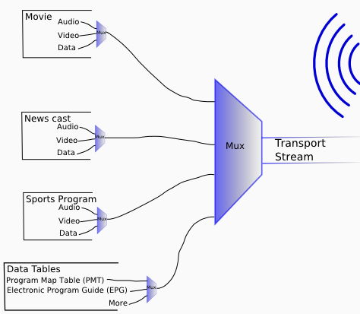
Transport Stream Multiplex
Transmission:
Terrestrial
Cable
Satellite
Broadband
Program Streams

Slide 7
MPEG
Motion Picture Experts Group
MPEG 1
audio and video coding - parts 1, 2, 3 (layers 1, 2, 3), 4, 5,
MPEG 2
audio and video coding - parts 1, 2, 3 (layers 1, 2, 3), …
MPEG 3 - originally for HDTV - abandoned
MPEG 4
audio and video coding - parts 1 - 22
MPEG 7
metadata, description
MPEG 21
framework for multimedia content delivery
XML-based; to communicate machine-readable license information
open framework for multimedia applications
"Rights Expression Language"

Slide 8
MPEG-1
Audio and video coding
Parts
1 - Synchronization and multiplexing of video and audio
- transport stream
2 - Compression codec for non-interlaced video signals
3 - Compression codec for perceptual coding of audio signals
- three layers of audio coding options (mp, mp2, mp3)
4 - Procedures for testing conformance
5 - Reference software
video CD format - quality ~ VCR
originally 1.5M bit/second data rates and 352x240 resolution
later up to 4M bit/second
the most compatible format in the MPEG family
only progressive scan video (... so need for MPEG-2)

Slide 9
MPEG-2
(1994) Audio and video coding
for broadcast - DVB (satellite, cable, DTT, etc), also DVD (with mofifications)
9 Parts, including -
1 - Transport Streams - TS
to carry digital video and audio in (unreliable) broadcast applications
Program streams carry audio and/or video data + time stamp data
2 - Video
similar to MPEG-1
support for interlaced video
optimised > 3 Mbit/s; not for low bit-rates (less than 1 Mbit/s)
backwards compatible to MPEG1
enhancements - used (to date) in most HDTV transmission systems
3 - Audio
layers 1, 2, 3
4, 5 - as MPEG-1
7 - Enhanced audio

Slide 10
MPEG-2 Audio
Part 3
new audio encoding (see later...)
low bitrate encoding with halved sampling rate
MPEG-1 Layer 1/2/3 LSF - low sampling frequency
multichannel encoding with up to 5.1 channels
... backwards compatible -
MPEG-1 audio decoders can decode stereo from MPEG-2 multi-chan audio
MPEG-2 AAC - Part 7
make better use of available bandwidth
non-backwards-compatible

Slide 11
Compression - Introduction

Slide 12
Why Compress Audio?
CD quality = 2* 44.1 *16 Kbps ≈ 1.4 Mbps
About 1/850 of HDTV video
1 hour of audio needs 3600* 1.4 /8 = 630 MB
100 songs take about 360 minutes ≈ 4 GB
Will we continue to compress audio –
Mobile devices may prefer to save battery power by not decompressing??

Slide 13
Why Compress Video
Size of uncompressed 1080p HDTV
1920 * 1080 ≈ 2 Mpixels per frame
For RGB this is 6MB per frame
Thus 1 s of video needs 25 *6MB = 150MB
Data rate of 150 *8 = 1200 Mbps = 1.2 Gbps
One hour of video needs 3600*150 MB
= 540,000 MB = 540 GB

Slide 14
Compressed and Uncompressed Images
raster
image
processing
time
display
compressed
image
display
processing
time

Slide 15
Compression Techniques: Lossless
uses techniques (tricks) to reduce data storage requirements whilst maintaining ability to reproduce original file exactly
possible because image is generally stored in a format that is logical and also compatible with the capture or display medium
lossless compression will generally compact data by processing it from the most logical or compatible structure to a format that requires minimal storage space
trades storage space for additional processing time

Slide 16
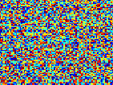
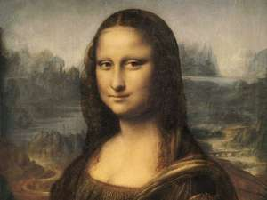
Compression – Information Theory
IF …
image is all the same colour
very easy to compress - just replace with colour value and codeword to indicate
every pixel is a random number between 0 & 255 and not correlated in any way with other pixels
it is impossible to compress
In between -
look for patterns only for lossless compression
additionally psychovisual characteristics for lossy compression

Slide 17
Lossless Compression
RLE replaces repeating bytes with number and kind:
e.g.777555555 becomes 3765
compression ratio 9:4 =2.25
In most applications RLE files are further compressed using Huffman which scans the whole file to discover the most frequently occurring bytes. These bytes are then translated to bit form, for example using only 1 bit for the most frequently occurring byte , 2 bits for the next most frequently occurring and so on

Slide 18
Bit Rate Reduction Principles
Main process of bit-rate reduction:
Remove lower priority information from the signal at encoder
... according to what we perceive in the image
Coding - including information about the bit-rate reduction
... codec at time of image capture
Decode - to assemble and play the compressed file
... codec at time of viewing image

Slide 19
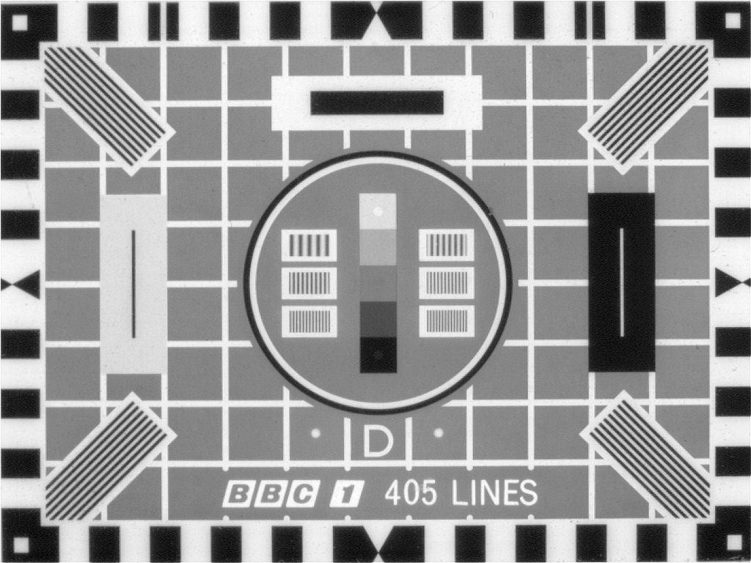
Audio Compression (Introduction)

Slide 20
Audio Compression
Audio Compression
Compression Usability, Latency
Encoding Architecture
Perceptual Coding: Psychoacoustic Models
Transform Domain Methods, Decoding
Coding, Bit Allocation, Frames
AAC - Advanced Audio Coding
MPEG-4 AAC, Low Delay Coder, Error Resilience,
Variable Bit Rate

Slide 21
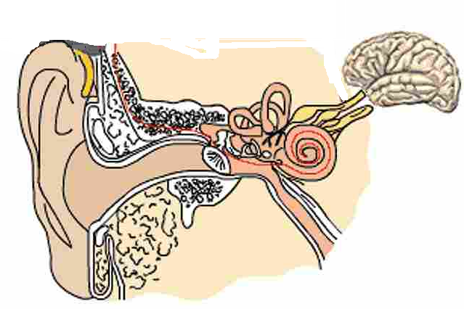
The Physiology of Hearing
Auditory Canal
acts as a closed tube resonator
enhances sounds in the range 2-5 KHz
Auditory Nerve
Ossicles
Cochlea
low + high frequencies
Stirrup
Tympanic Membrane
Pinna
presents larger area to received sound energy
“collects” sound – like a preamplifier

Slide 22
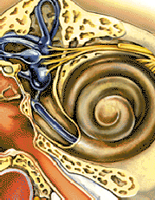
The Physiology of Hearing – The Cochlea
High frequency sounds
schematic view - unroll the cochlea - distribution of sensitive hair cells
Lower frequencies
hair cells
incoming sounds
nerve endings

Slide 23
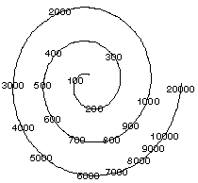
The Physiology of Hearing – The Cochlea
http://www.hitl.washington.edu/publications/hollander/2.html
low + high frequencies

Slide 24
The Physiology of Hearing
freq
critical band
freq
Two signals within a critical band - closely related in frequency
stimulate the same area of the membrane in the cochlea
these two sounds added together don’t give twice the loudness
critical band
critical bands
freq
Two signals - frequencies separated
stimulate the different areas of the membrane in the cochlea
not competing for the same nerve endings
give an appreciable increase of perceived intensity

Slide 25
Psychoacoustics
Frequency dependent resolution:
Human inability to discern minute differences in frequency
within the critical bands
Auditory masking:
Two signals in a critical band: the louder will mask the softer
(either completely or to a certain extent)
A masked signal must be louder than some threshold for it to be heard
User selection of bit rates: file size vs quality

Slide 26
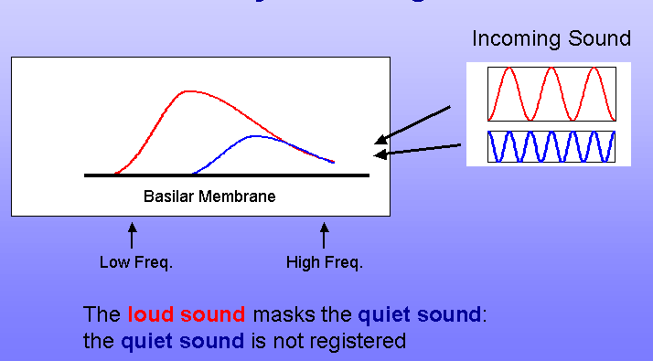
Psychoacoustic Models
Model - To determine perceptually irrelevant information in the signal
an assimilation of human perception of (coincident) sounds
component frequencies allocated bits according (perceived) audibility
Auditory Masking
http://www.head-fi.org/t/610161/lightbox/post/8384518/id/604385

Slide 27
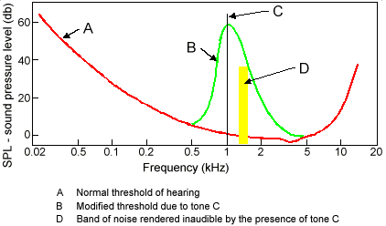
Threshold of Hearing, Masking Threshold

Slide 28
MPEG Psychoacoustic Models
MPEG standard defines two models:
Psychoacoustic Model 1:
simpler, less computationally expensive
serious compromises in what it assumes a listener cannot hear
Psychoacoustic Model 2:
More features
more complex coding (assuming increased processor bandwidth)
Layer III (.mp3)

Slide 29
Temporal Masking
Temporal
- faint sounds not heard following loud sounds
Layer 1 - smaller frames - no temporal knowledge
Layers II, III - do support temporal masking

Slide 30
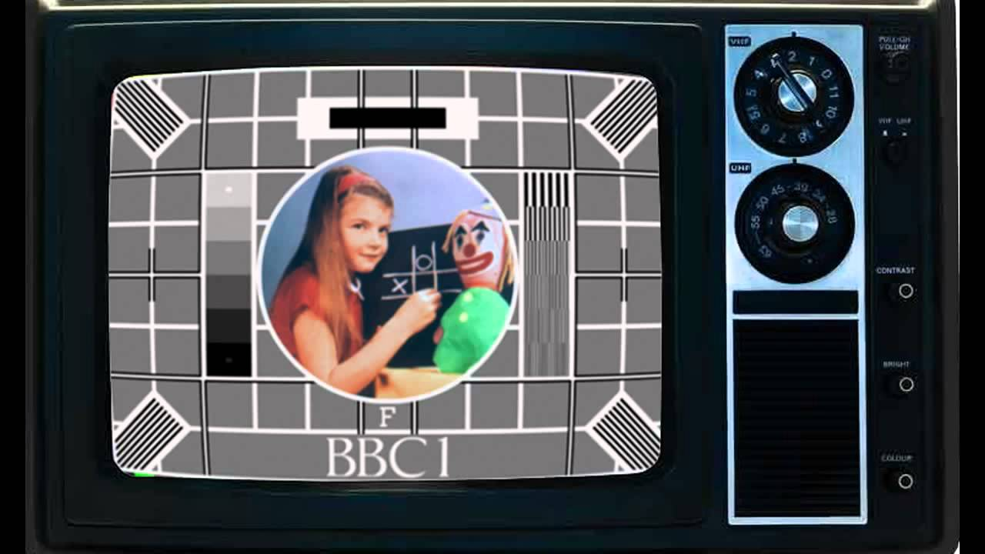
Video Compression (Introduction)

Slide 31
Image Compression – A Number of Stages are used:
Lossy
Chroma Subsampling
DCT-based (harmonics/synthesis) compression
Lossless
iii. Huffman (statistical) coding

Slide 32

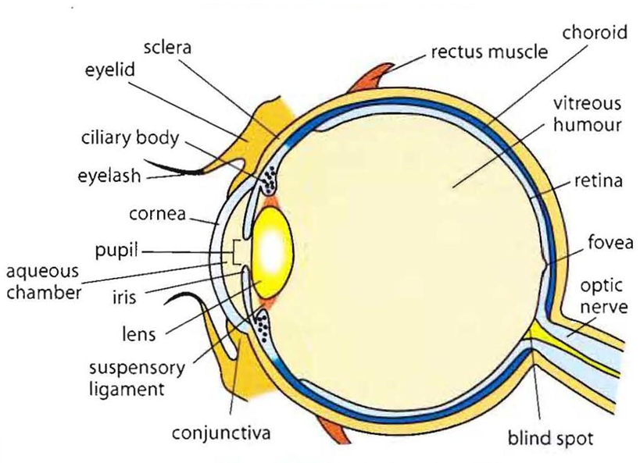
The Eye
The Eye
The Eye

Slide 33
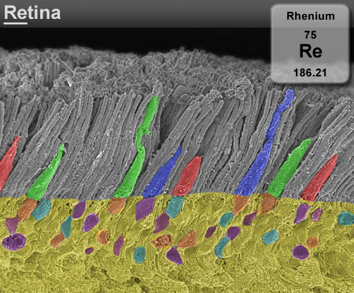
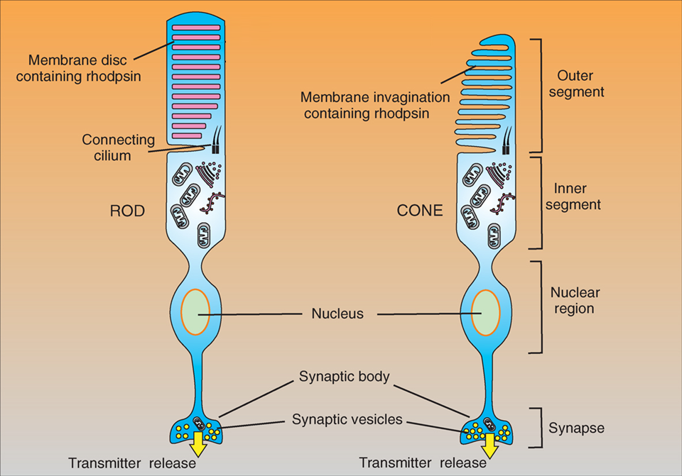
Receptors
… Rods and Cones
http://www.cellsignallingbiology.org/csb/010/csb010fig10_rod_and_cone_structure.htm

Slide 34
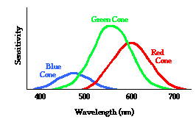
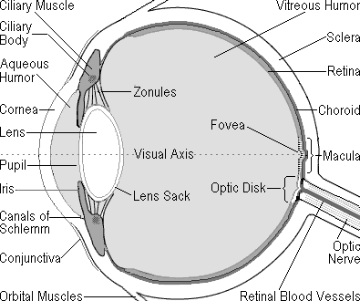
Psychovisual – how we perceive images
Light sensitivity in the eye
Rods - light intensity - not colour
~125 million across the retina
characteristics of high speed black & white film
Cones - colour - responsive in three wavebands
6 or 7 million cones
characteristics of low-speed colour film
RODS and CONES
(retina)
... Chroma Sub-sampling

Slide 35
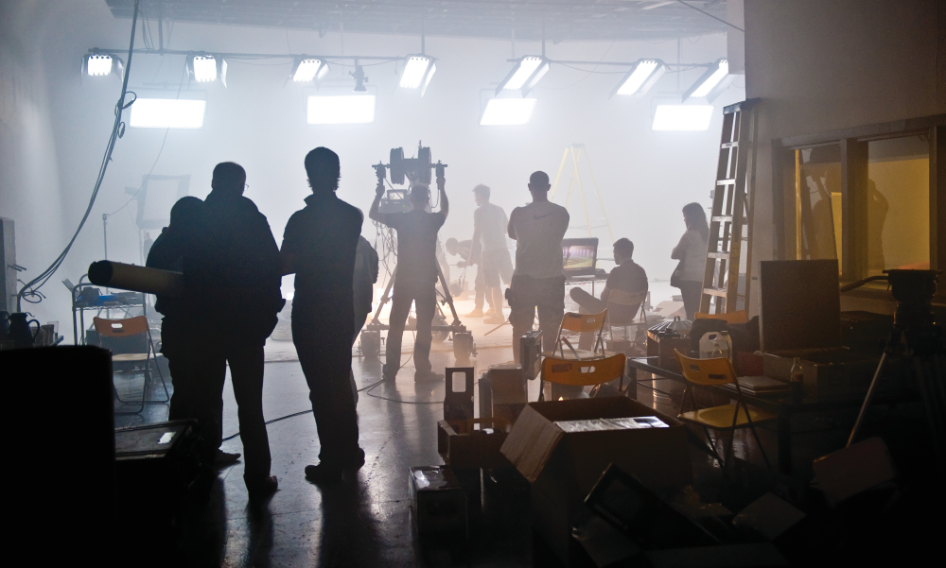
Images Captured on a Camera
Original captured image at camera sensor:
Image captured on red blue and green – responsive photo-sites
each pixel is represented by R, B, G
each pixel has its own value of light intensity

Slide 36
RGB to Y,Cb,Cr
Y
During the encoding stage ...
Cb
RGB pixel format … … … is converted to … … … Y,Cb,Cr
where
Y = luminance (light intensity)
Cb, Cr = colour information
Cr
Weighted RGB converted to Y Cb, Cr
0.2989*R + 0.5870*G + 0.1140*B

Slide 37
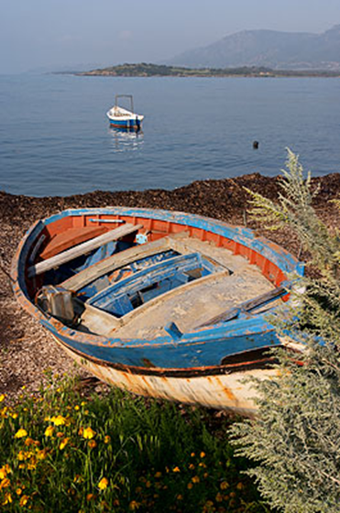
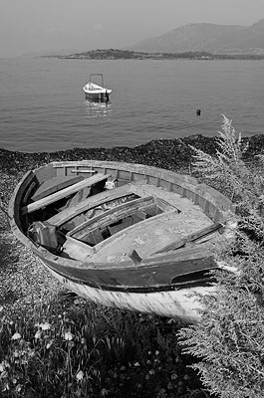
RGB to Y,Cb,Cr – each pixel
Overall luminance
i.e. greyscale, monochrome
of this pixel
= Y, ... i.e. the luma
Weighted RGB luminance:
approx 29% Red + 59% Green + 11% Blue

Slide 38
RGB to Y,Cb,Cr – each pixel
Cb = B – Y
i.e. 8 bits of Cb (0-255)
value of Cb:
value of original Blue
minus
value of luma
= -
e.g.
= 210 - 90
1111000
11010010
similarly,
Cr = R – Y
= -
01011010
Overall luminance
i.e. greyscale, monochrome
of this pixel
= Y, ... i.e. the luma
Weighted RGB luminance:
approx 29% Red + 59% Green + 11% Blue

Slide 39
Y,Cb,Cr – for image of x x y pixels in “4:4:4”
y pixels
x pixels

Slide 40
Y,Cb,Cr – Chroma Sub-sampled to “4:1:1”
y pixels
Reason: To greatly reduce the amount of data
Rationale: The eye’s resolution of luminance is greater than for colour
x pixels

Slide 41

Y,Cb,Cr
Original image
YCbCr
Colour Space: Y = Luminence Information; Cr, Cb = Chrominance Information
Derived from RGB (gamma corrected)
Y is dominant information; RGB colour info derived from Y, Cr, Cb relationships
(simplified): Cb = B-Y ; Cr = R-Y
Y
Cb
Cr

Slide 42

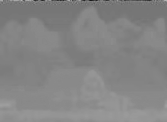


RGB to Y,Cr,Cb
i.e. there are now three mappings of the original RGB image:
Y: Luminance intensity
Cb: Intensity of the values of
[B minus Y]
Cr: Intensity of the values of
[R minus Y]
Y
Y
Cb
Cb
Cr
Cr

Slide 43
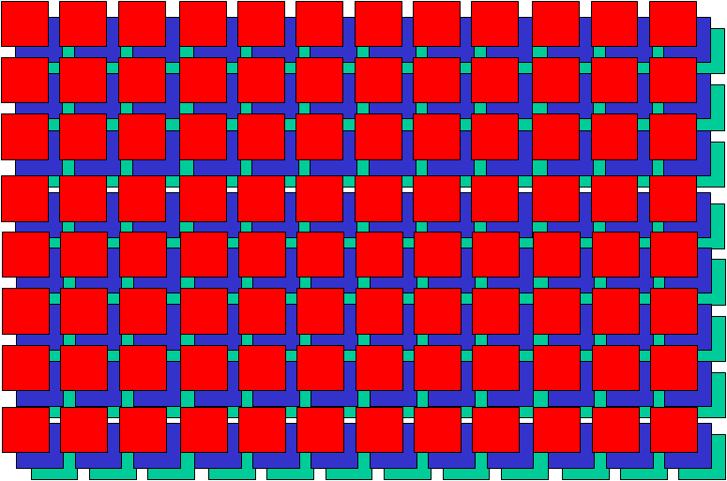
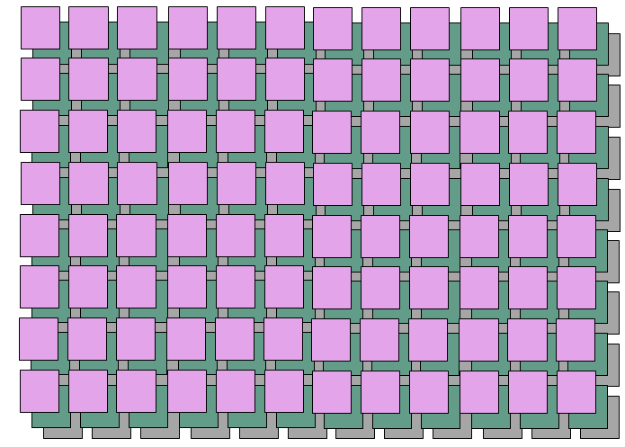
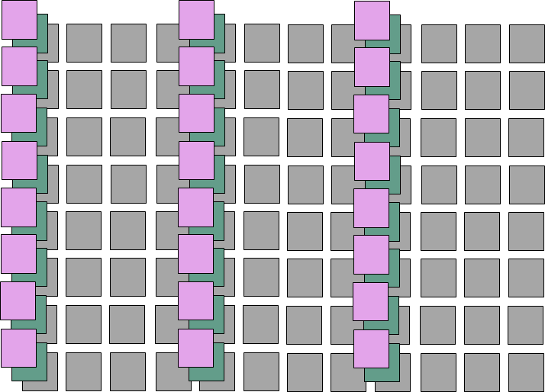
Chroma Subsampling
Left – original RGB image:
12 x 8 pixels = 96 pixels
bits for each pixel = 8 red + 8 green + 8 blue
∴ 24b each pixel, total bits = 24 x 96 b
= 2304b (= 288 Bytes)
Bottom left, YCbCr, 4:4:4 : (is also 2304b)
Below, Chroma sub-sampled, 4:1:1:
Luma = 96 x 8 = 768
Chroma = 3 columns of Cr and Cb,
2 x 8b each C = 8 x 2 x 3 x 8 = 384 b
Total = 768+384 = 1152b (=144 B)
i.e. 50% saving

Slide 44

Reception / Decoding
encoding process
decoding process
Decoding, reverse process ...
from Chroma sub-sampled to full RGB
note – interpolating lost information
∴ detail is lost in the process
Perceptual (e.g. MPEG, etc ) encoding + decoding is also part of this process and loses a lot more detail
... more later in the module

Slide 45


Chroma Subsampling
Luma and chroma components
Weighted sum of gamma-corrected R'G'B‘ tristimulus components
instead of linear (tristimulus) RGB components
Luminance and colour detail are not completely independent of each another
"bleeding" of luminance and colour information between the luma and chroma components
i.e. because of the colour not represented in each pixel, and is interpolated for the final viewed image
greatest for highly-saturated colours
noticeable in between the magenta and green (when chroma subsampled)
without colour subsampling
with colour subsampling

Slide 46
Chroma Subsampling
commonly expressed as a three part ratio J:a:b (e.g. 4:2:2)
number of luminance and chrominance samples in a conceptual region
J pixels wide
2 pixels high
Parts
J = horizontal sampling reference (width of the conceptual region)
usually = 4
a = number of chrominance samples (Cr, Cb) in the first row of J pixels
b = number of changes of chrominance samples (Cr, Cb) between first and second row of J pixels
Alpha - horizontal factor (relative to first digit)
omitted if alpha component is not present
equal to J when present

Slide 47
Chroma Subsampling
Y = Luminance Cb = Blue - Luma
Cr = Red - Luma
(Note - Cb and Cr is colour difference information for the related pixel; not the red/blue value itself!)
4:4:4 - High end applications
4:1:1 - Widely used in JPEG and MPEG
full horizontal resolution, full vertical resolution
¼ horizontal resolution, full vertical resolution
4:2:2 - Used in Studio recordings
4:2:0 - Used in DVD, JPEG, MPEG
½ horizontal resolution, full vertical resolution
½ horizontal resolution, ½ vertical resolution

Slide 48
MPEG –
Coding For
Moving Images
Intraframe and Interframe Compression

Slide 49
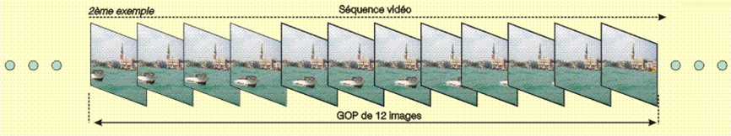
GOPs – Groups Of Pictures
Video Sequence
Group Of Pictures (GOP)
Group of Pictures (GOP)
Header + series of one of more pictures
3 types of pictures: I, P, B
Provides a regular structure of video content
recurring pattern of pictures
allow easy access to the video stream
For TV the GOP is 12 pictures ( 0.5 s of a projected at 24 frames / s movie
For NTSC 30 fps, uses 15 pictures

Slide 50
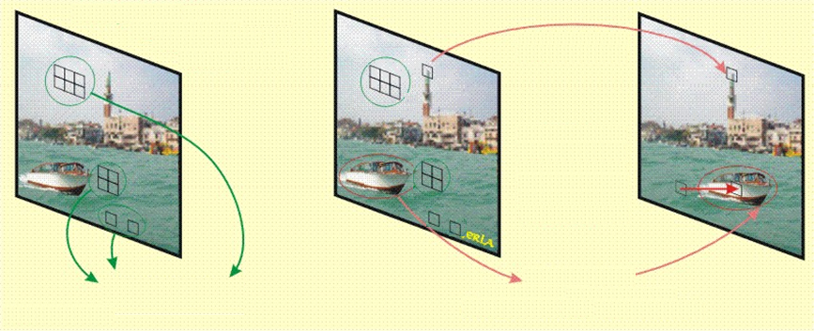

Basic Principles for Moving Elements in Images
Blocks Identical or nearly-identical in following frames
Blocks with nearly* identical characteristics are replicated; spatial displacement is coded with a motion vector
*we’ll deal with the “nearly” part shortly …

Slide 51
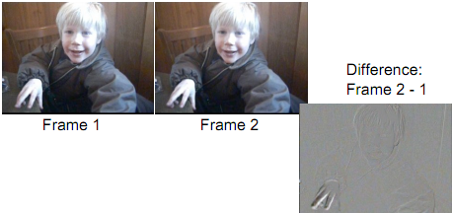
Difference Coding
Amount of information in the difference between the two frames is a lot less than in Frame 2
motion in the scene will increase the differences
analyse motion
… where each block moved since previous frame
encode motion as vector -
x- and y- direction vectors
encode differences for the moved block like a jpg,
i.e. DCT, quantization, RLE (zig-zag), Huffman
(… but this jpeg is very simple to encode due to little changed information in the image)
see - http://www.cs.ucl.ac.uk/teaching/GZ05/08-h261.pdf

Slide 52
Streaming
HTTP, HLS
MPEG-DASH
RTP/RTSP

Slide 53
HTTP Streaming
The original solution for streaming
... overtaken by RTP/RTSP based for large IPTV deployments
... more recently back in favour
used generic HTTP servers (often based on Apache or Windows Server)
Early days
Limited bandwidth available
“Download and play”
no lookahead seeking or random access
Multiple viewers – server bandwidth issues
Apple introduce progressive download

Slide 54
Streaming Media Protocols – HTTP addresses RTMP Issues
HTTP server/client – stateless
HTTP-streaming: retrieves consecutive short chunks on as-needed basis
little waste (the video is delivered as it is watched)
server efficiently serves more streams
Random seeking
(viewer selects – player retrieves the appropriate chunks)
firewall friendly
can utilise HTTP caching mechanisms
less expensive to implement (no streaming server required)
scale more cheaply and effectively to serve available users
RTMP/RTSP/HTTP – state of the market
little impetus for RTMP/RTSP sites to change –still widely used
new installations - overwhelming view – HTTP
in fact most video content is delivered via plain old HTTP progressive download

Slide 55
HTTP Streaming
Segment timing:
10 seconds = reasonable balance for most broadcast content
Shorter segments
= more frequent refreshes of the index file
.. unnecessary network overhead for the client
Longer segments
= latency and initial startup time
Media Formats
e.g. video: H.264 / VP9,
audio: .aac / Opus, etc
video + audio file segments unwrapped
… but certain applications –
can be wrapped in MPEG-TS (DVB)
Client
Server
http GET
Audio segment
http GET
Video segment
etc

Slide 56
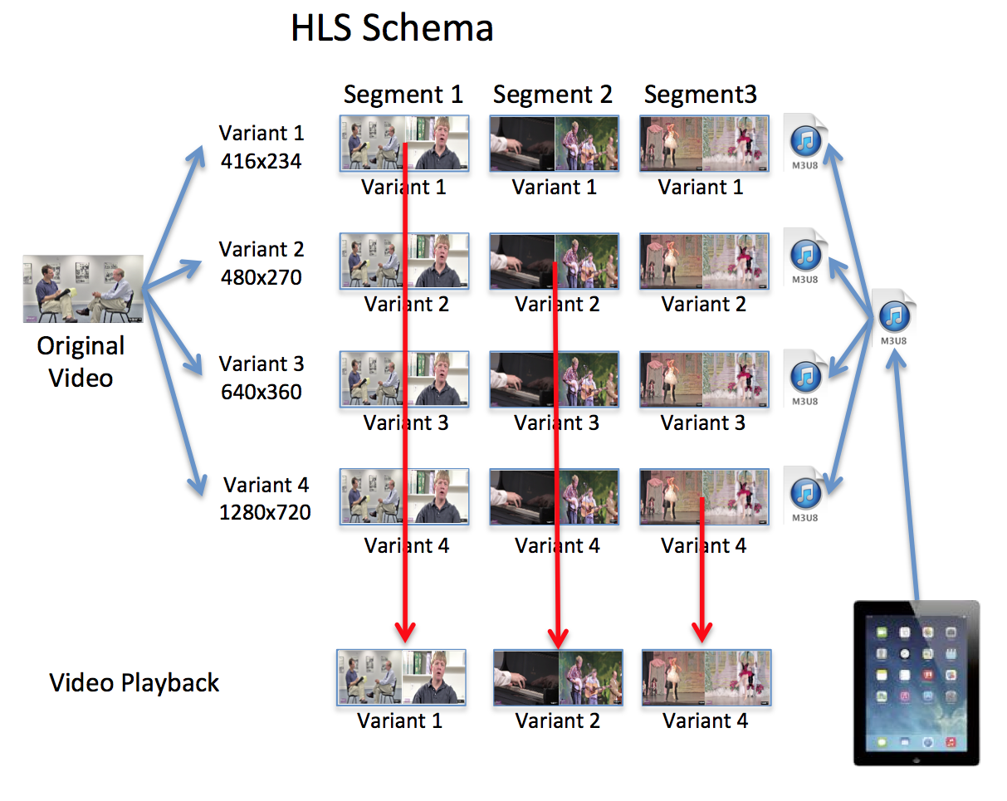
HTTP Live Streaming - HLS (DASH is similar)
Apple (part of QuickTime and iOS)
HLS v5 announced in Sept16
support for Fragmented MP4

Slide 57
Production and Distribution Technology UG2
T3: Harmonic Analysis
Jerry Foss
jeremy.foss@bcu.ac.uk

Slide 58
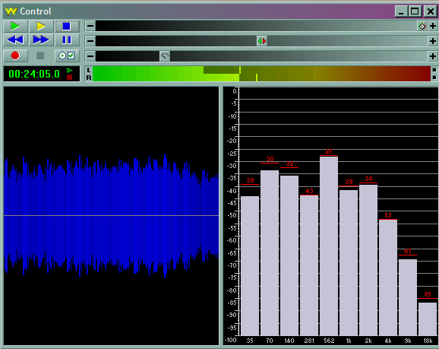
Time and Frequency Domains
represents a signal as a mathematical function a computer* can handle
*computer = PC, Set Top Box, Console, player …
converts a time-based signal into a frequency-based signal for processing
… and back again for playout
Time Domain
Frequency Domain
signal amplitude
signal amplitude
time
frequency
From the Goldwave Audio editing program

Slide 59
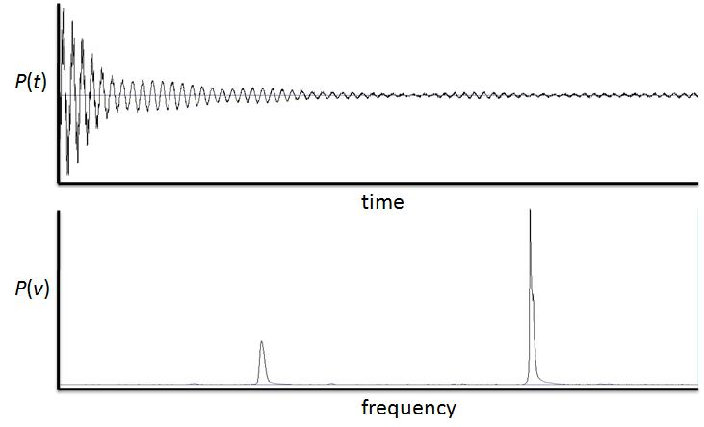
Time and Frequency Domains

Slide 60

Series
Mathematical Series, example:
limits
sum

Slide 61
Harmonics
Fundamental
(1st Harmonic)
2nd Harmonic
3rd Harmonic
4th Harmonic
5th Harmonic
6th Harmonic
:
:
12th Harmonic

Slide 62
Waveform Synthesis
f = sin(x)

Slide 63
Waveform Synthesis
f = sin(x)
f = 1sin(3x)
3

Slide 64
Waveform Synthesis
f = sin(x)
summation of amplitudes
f = 1sin(3x)
3

Slide 65
Waveform Synthesis
f = sin(x)
summation of amplitudes
f = 1sin(3x)
3
f = sin(x) + 1sin(3x) 3

Slide 66
Waveform Synthesis
f = sin(x)
summation of amplitudes
f = 1sin(3x)
3
f = sin(x) + 1sin(3x) 3
f = 1sin(5x)
5

Slide 67
Waveform Synthesis
f = sin(x)
summation of amplitudes
f = 1sin(3x)
3
summation of amplitudes
f = sin(x) + 1sin(3x) 3
f = 1sin(5x)
5

Slide 68
Waveform Synthesis
f = sin(x)
summation of amplitudes
f = 1sin(3x)
3
summation of amplitudes
f = sin(x) + 1sin(3x) 3
f = 1sin(5x)
5
f = sin(x) + 1sin(3x) + 1sin(5x) 3 5

Slide 69
Fourier Series – (here just the sine)
increasingly high frequency components … (usually) lower amplitudes
…...
where:
= the fundamental frequency
= amplitudes of successive terms
n = the series
ωt = 2πf (f= frequency)
i.e. the
coefficients
… Discrete Cosine Transform is similar

Slide 70
sin and cos
Compare sin and cos:
note that for any value of sin, cos got there 90° earlier
i.e. cos leads sin by 90 °
... or sin lags cos by 90 °
sin α
0 90 180 270 360 450 540 630 720 810 900
cos α

Slide 71
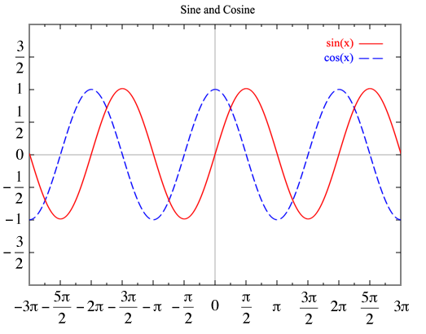
Fourier Series
An expansion of a periodic function f(x) (or f(t))
in terms of an infinite sum of sines and cosines
makes use of the orthogonality relationships of the sine and cosine functions (odd / even functions)

Slide 72
Fourier Series
increasingly high frequency components … (usually) lower amplitudes
…...
Series contains sin and cos to accommodate for odd and even functions of f(t)
where:
= the fundamental frequency
= amplitudes of successive terms
n = the series
ωt = 2πf (f= frequency)
i.e. the
coefficients

Slide 73
Waveform Synthesis - Fourier Transforms
increasingly high frequency components … (usually) lower amplitudes
…...
Note – the highest frequency in the series is the Nyquist frequency (i.e. below half the sampling frequency)
e.g. in this waveform (comprising only sine functions):
(1)
f = sin(x) + 1sin(3x) + 1sin(5x) 3 5

Slide 74
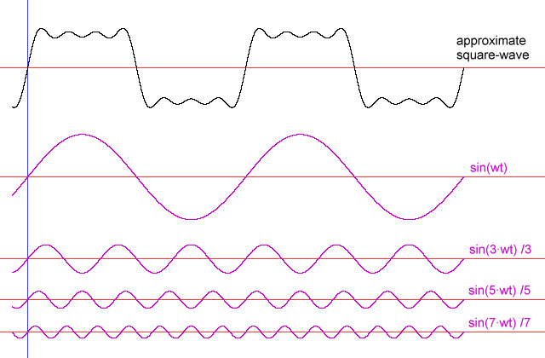
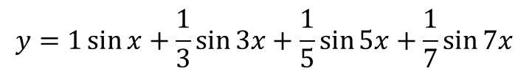
Time Domain – to Frequency Domain
Example – the square wave and its sine-wave components
Harmonics
$$y=1\sin{x+\frac{1}{3}\sin{3x+\frac{1}{5}\sin{5x+\frac{1}{7}\sin{7x}}}}$$
Coefficients (i.e. amplitudes)
freq

Slide 75
Perceptual Coding
for JPEG Image Compression

Slide 76
Frequency: amplitude with time
sin α
angle α
0 90 180 270 360 450 … etc
sin α

Slide 77
“Spatial” Frequency (horizontal)
sin α
angle α
0 90 180 270 360 450 … etc
sin α

Slide 78
“Spatial” Frequency (vertical)

Slide 79
“DC Conditions”
sin α
angle α
0 90 180 270 360 450 … etc
sin α
1
0
1 volt
angle α
0 90 180 270 360 450 … etc
i.e. the whole sin α waveform has been lifted by a constant 1 volt

Slide 80


DC Conditions … in an image ???
+
0
-

Slide 81
The image is the correlation of …
Image broken in to 8 x 8 pixel blocks
The codec decides how to describe each block as a correlation of ...
… this harmonic content
+ this harmonic content
+ this DC

